Slide 2
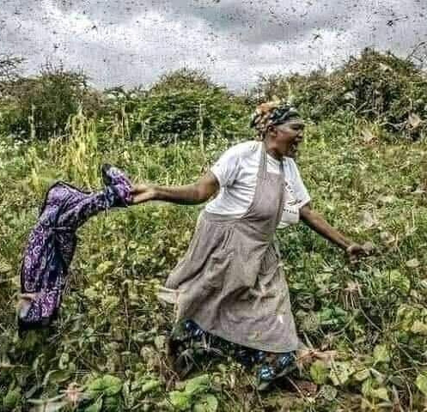
Introduction
Our project is located in Sululta, Ethiopia. The Mushroom Project started in response to the Locust plague that hit Ethiopia hard at the end of 2020.
October 2020 farmers across Ethiopia faced one of the worst locust outbreaks in decades. The locusts destroyed crops across the country that were a source of food and income to 20 million people.

Slide 3
Introduction
The Mushroom Project was created in a way that it can start off small and strong and expand as the farmer harvests crops that can be multiplied. The project is highly sustainable as the first crop continues to give and allows the farmer to grow their mushroom seeds for the next crop.
Mushrooms have a very quick turnaround time of 7-14 days and will produce enough spores to grow their next crop and then some. The farmer will be able to slowly grow their farm crop after crop.

Slide 4
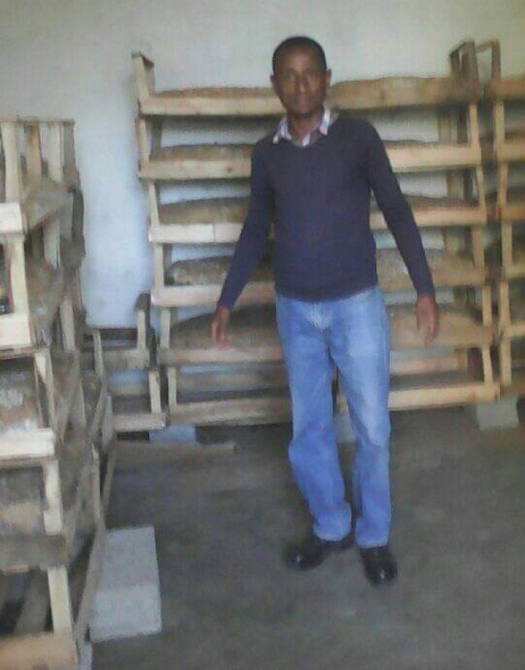
Who We Are
Fekadu, a father and a local Ethiopian, knows the true impact that this locust plague has had on him, his family and other community members. Fekadu also helps us with one of our larger Devxchange projects currently, Forestry For Life. From working with this project for 10 years, Fekadu is the perfect person to start this project with.
He brings to the table a unique collection of skills, having more than 10 years experience in plant science, project management, and agriculture.

Slide 5
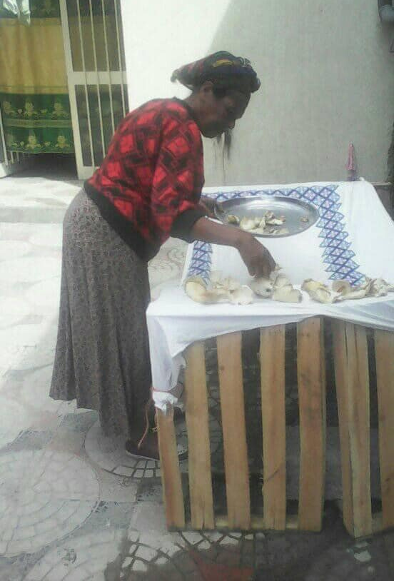
Nutritional Benefits
Mushrooms are packed with nutritional and medicinal values. Mushrooms are rich sources of vitamins and minerals; selenium, zinc, vitamin B1, B2, B5, B6 and B12. They also are full of antioxidants and do not contain fat or carbohydrates. They are the only vegetable that contains vitamin D naturally as a result of their exposure to sunlight. Any farmers we train will learn the amazing benefits of eating mushrooms.

Slide 6
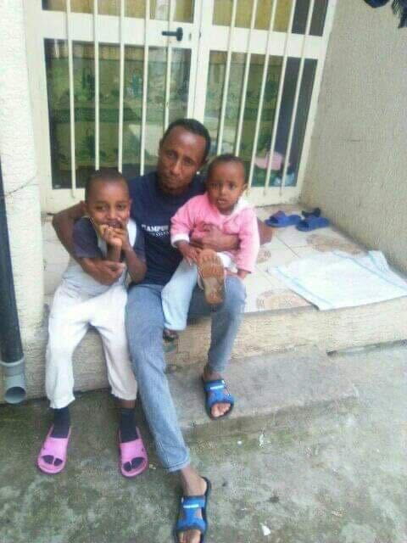
Financial Benefits
For families in Ethiopia, to have an opportunity to start a mushroom farming business means that they can start seeing an income quickly, scale up sustainably and lift their families out of poverty.
An income means they can afford to buy their children school supplies and pay for tuition, put food on the table and clothes on their backs, have adequate shelter and pride that they were able to do it on their own.

Slide 7
Thank you
We are thrilled with your interest to partner with us and help create sustainable farms that can help lift families out of poverty.

